Slide 1
P
C
S
18 September 2021 from 1000 to 1500 GMT
In collaboration with
Supported by

Slide 2
Proposal
Society for endocrinology
European society of endocrinology
Verity
PCOS vitality
Health Education West Midlands
PCOS Club India
Interested healthcare professionals
Invited people with PCOS
Simulation based learning
Workshop styled learning
Case discussion with Q&A

Slide 3
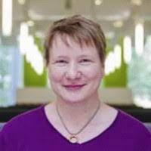
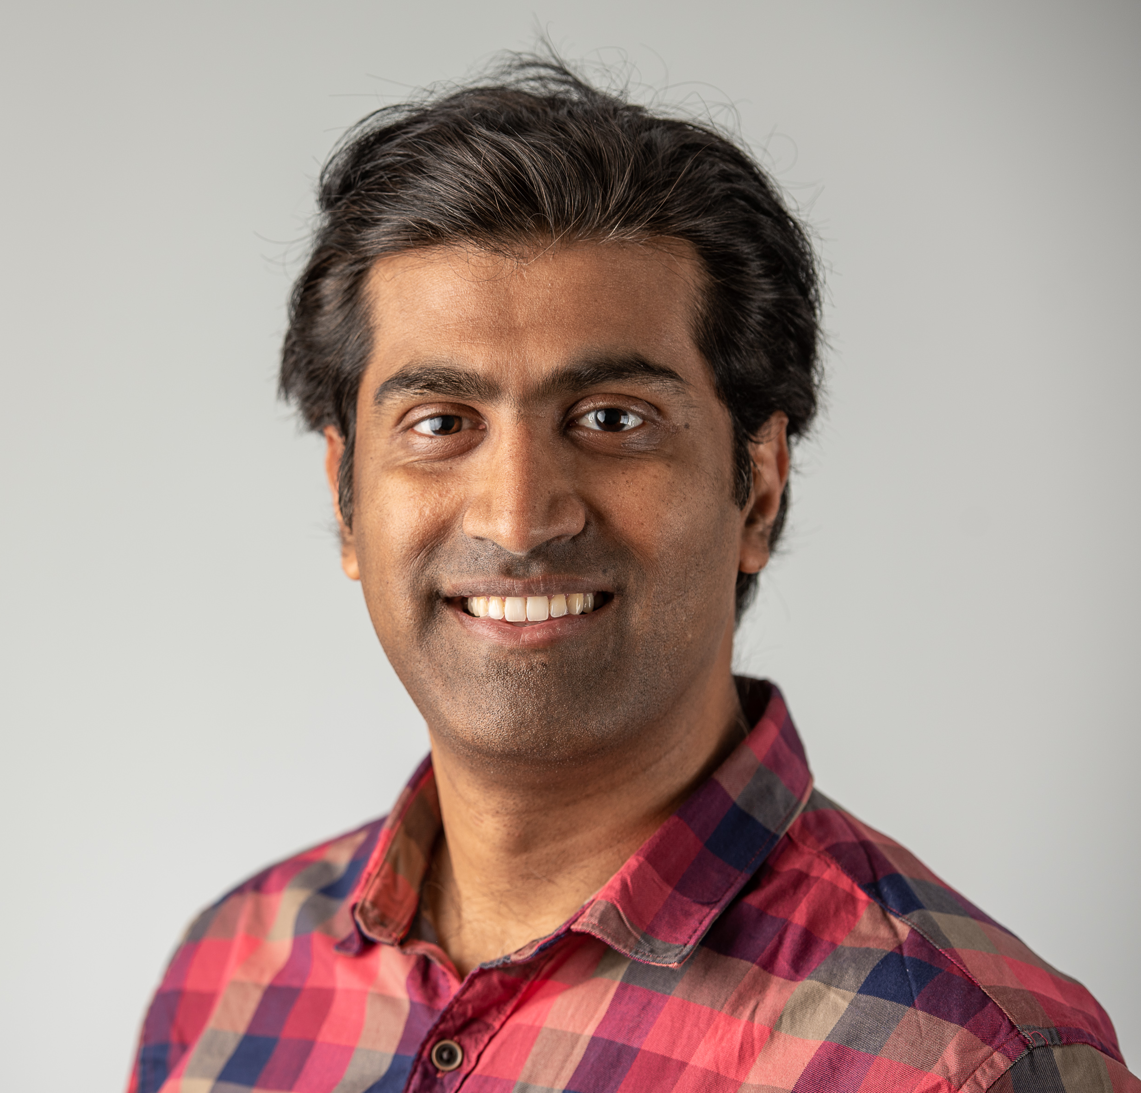
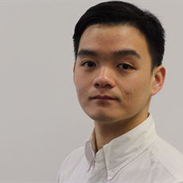
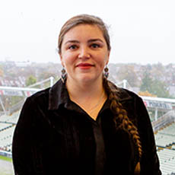
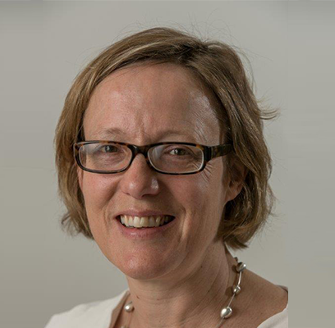
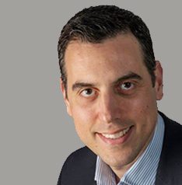
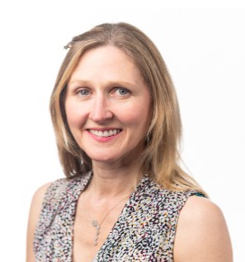
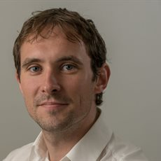
Prof Wiebke Arlt
Director, IMSR
University of Birmingham
Dr Punith Kempegowda
Chair, SIMBA
University of Birmingham
Dr Eka Melson
Foundation Year Doctor
NHS Tayside, Scotland
Dr Caroline Gillett
IMSR Lead for Public Engagement
University of Birmingham
Dr Helena Gleeson
Consultant Endocrinologist
University Hospitals Birmingham, UK
Dr Konstantinos Manolopoulos
Human Metabolism Expert
Kalamata, Greece
Miss Lynne Robinson
Consultant Gynaecologist
Birmingham Women’s Hospital
Dr Michael O’Reilly
Consultant Reproductive Endocrinologist
Royal College of Surgeons in Ireland

Slide 4
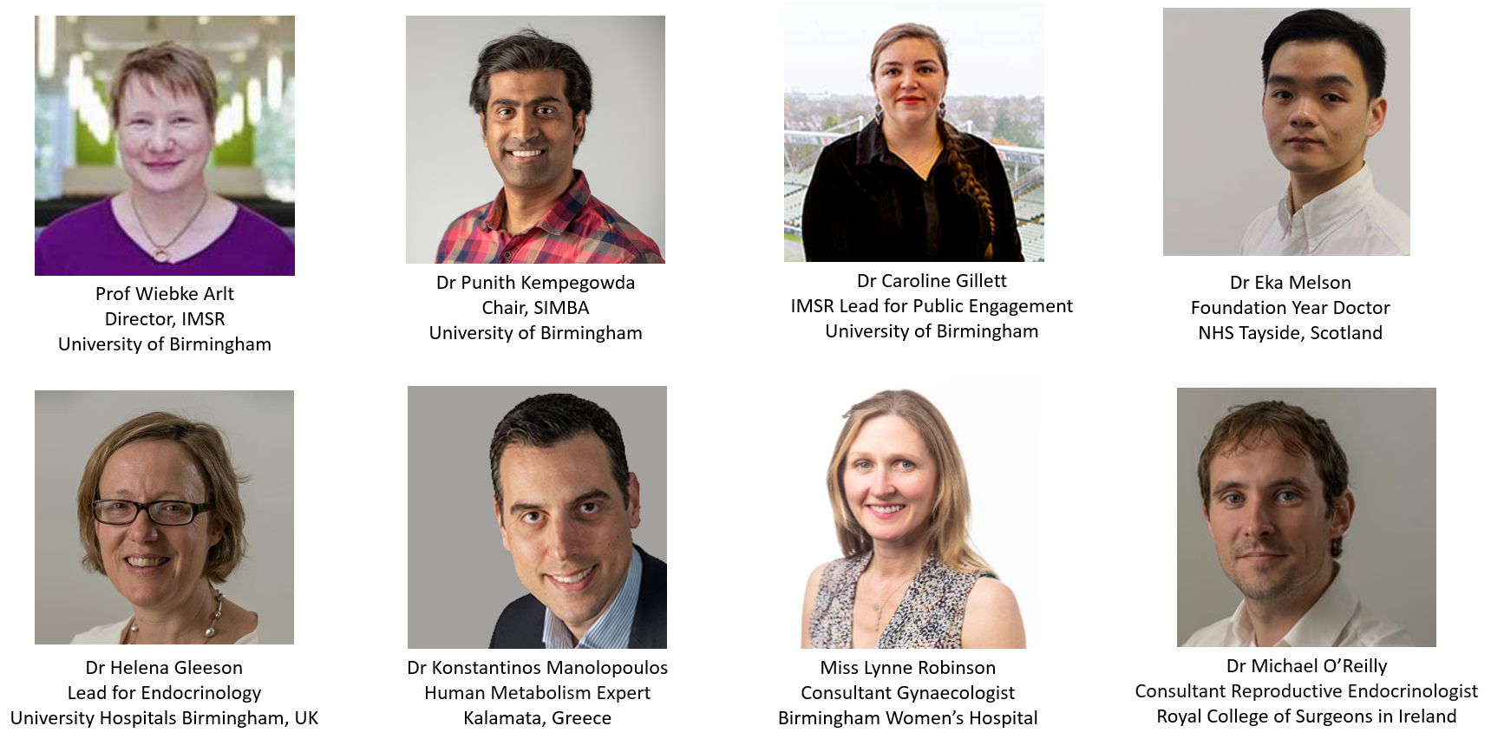
18 September 2021 from 1000 to 1500 GMT
 | Healthcare professionals |  | People with PCOS
Time | Topic | Speaker | Topic | Speaker | Chair
10:00 - 10:10 | Opening Welcome | SIMBA team | Opening Welcome | DAISy-PCOS team | Punith Kempegowda
10:10 - 10:15 | Pre-simulation survey |  | Pre-workshop survey
10:15 – 10:40 | Simulation Case 1 |  | Workshop Case 1
10:50 - 11:15 | Simulation Case 2 |  | Workshop Case 2
11:20 – 11:45 | Simulation Case 3 |  | Workshop Case 3
11:50 - 12:15 | Simulation Case 4 |  | Workshop Case 4
12:20 – 12:30 | Introduction to discussion |  |  | Caroline Gillet | Wiebke Arlt
12:30 – 13:00 | PCOS and Skin |  |  | Helena Gleeson
13:00 – 13:30 | PCOS and weight excess |  |  | Konstantinos Manalopoulos
13:30 – 14:00 | PCOS and fertility |  |  | Lynne Robinson
14:00 - 14:30 | PCOS and menstrual irregularities |  |  | Michael O’Reilly
14:30 – 14:45 | Feedback, post-meeting survey and Closing Comments |  |  | Caroline Gillet

