Slide 1
European Society of Endocrinology Clinical Practice Guidelines on the Management of Adrenocortical Carcinoma in adults, in collaboration with the
European Network for the Study of Adrenal Tumors
Martin Fassnacht (Germany), Olaf M. Dekkers (The Netherlands), Tobias Else (United States), Eric Baudin, France, Alfredo Berruti (Italy), Ronald R. de Krijger (The Netherlands), Harm R. Haak (The Netherlands) , Radu Mihai (United Kingdom), Guillaume Assie (France), Massimo Terzolo (Italy)

Slide 2



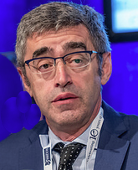





The ESE-ENSAT Guidelines Panel
10 experts from 6 countries
Endocrinologists
Methodologist
Tobias
Else
USA
Harm
Haak
The Netherlands
Guillaume
Assié
France
Massimo
Terzolo
Italy
Martin Fassnacht
Germany
Olaf
Dekkers
The Netherlands
Oncologists
Endocrine Surgeon
Pathologist
Eric
Baudin
France
Alfredo Berruti
Italy
Radu
Mihai
UK
Ronald
de Krijger
The Netherlands

Slide 3
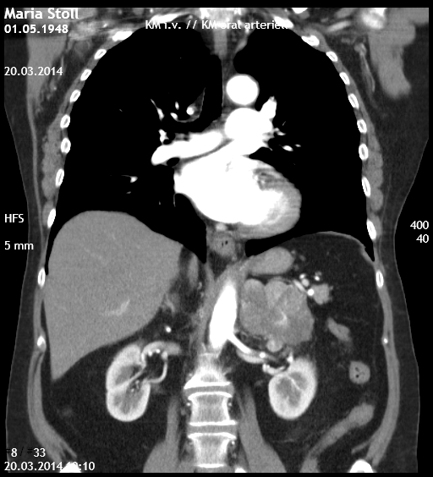
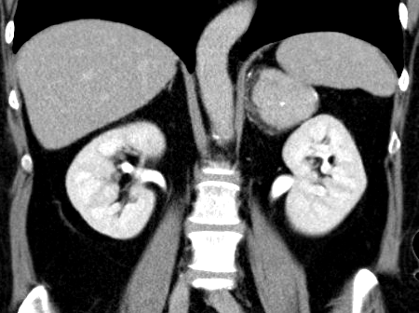
Two typical cases with adrenocortical carcinoma (ACC)
Maria, 43 y
Cushing‘s syndrome
6.5 cm adrenal tumor
Surgery 5.4.2010
She died June 2011 of advanced ACC
Christina, 44 y
“Incidentaloma” (<= back pain)
6.3 cm adrenal tumor
Surgery 15.6.2010
She is still alive without evidence of disease
What can we do that all patients will have a better outcome?

Slide 4
Aim of the guidelines
Provide for the first time evidence-based clinical practice guidelines for
  Diagnosis
  Treatment
  Prognosis
of patients with adrenocortical carcinoma (ACC)

Slide 5
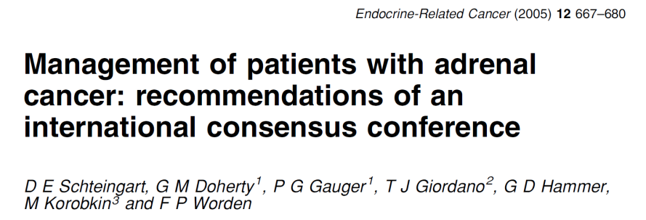
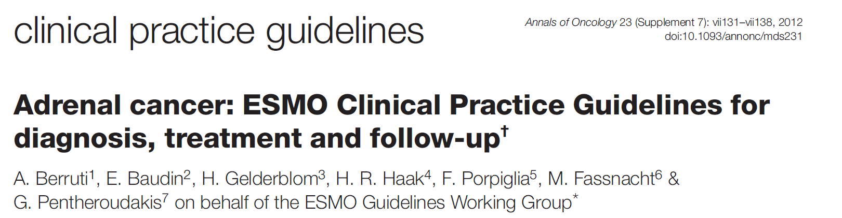
Current situation
No generally accepted international guidelines are available for ACC
In addition to reviews by experts there are only two “guideline-like” papers:
However, for both no systematic literature search was performed

Slide 6
Guideline development process
Sept 2016: ESE Clinical Committee initiated the guideline group
3 face-to-face meetings: Nov 2016 Birmingham, September 2017 Frankfurt, March 2018 Leiden
Multiple telephone conferences + thousands of emails
At first, 30 clinical questions including 4 key questions were defined, for which a detailed literature search was done
13.May–10.June 2018: 3 expert reviewers (Mouhammed Habra, Electron Kebebew, and Britt Skogseid) and all ESE and ENSAT members were asked to comment on the guidelines
Guidelines were published in August 2018 in the European Journal of Endocrinology

Slide 7
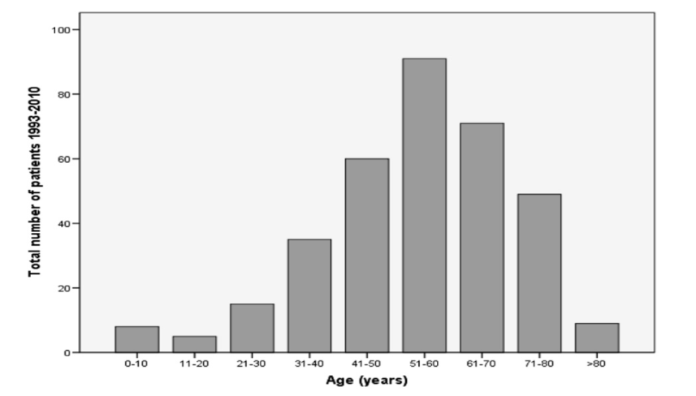
Epidemiology
Data on the incidence are scarce
Most reports suggest an annual incidence between 0.5 – 1.5
per million population (Kebebew et al. W J Surgery 2006,
Goldon et al. JCEM 2009, Kerkhofs et al. Eur J Cancer 2013)
All series describe a female dominance (ratio 1.5 : 1)
Kerkhofs et al. Eur J Cancer 2013

Slide 8
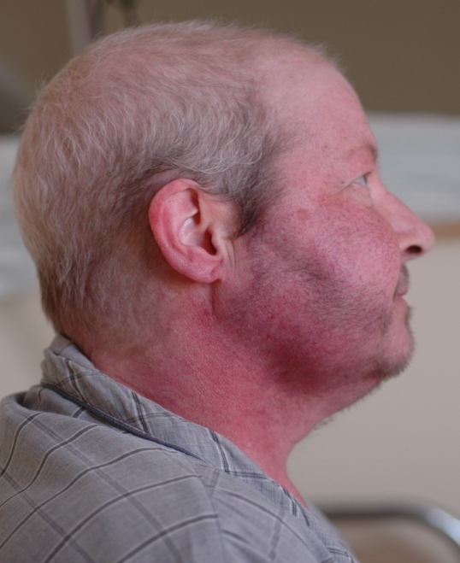
Symptoms of ACC
Symptoms at primary diagnosis:
  hormone excess (50-60%)
    Cushing’s syndrome
    Androgen excess
    Estrogen excess
    Conn syndrome (extremely rare)
  local symptoms (30-40%)
  “incidentally detected” (10-15%)
Woman with
androgen-producing ACC

Slide 9
Our first recommendation
(not based on publications, but we feel strong about it)
R.1.1. We recommend that all patients with suspected / proven ACC are discussed in a multidisciplinary expert team meeting
with adrenal expertise in :
  Endocrinology
  Oncology
  Pathology
  Radiology
  Surgery
This team should have access to
expertise in:
Interventional radiology
Radiation therapy
Nuclear medicine
Genetics
Palliative care

Slide 10
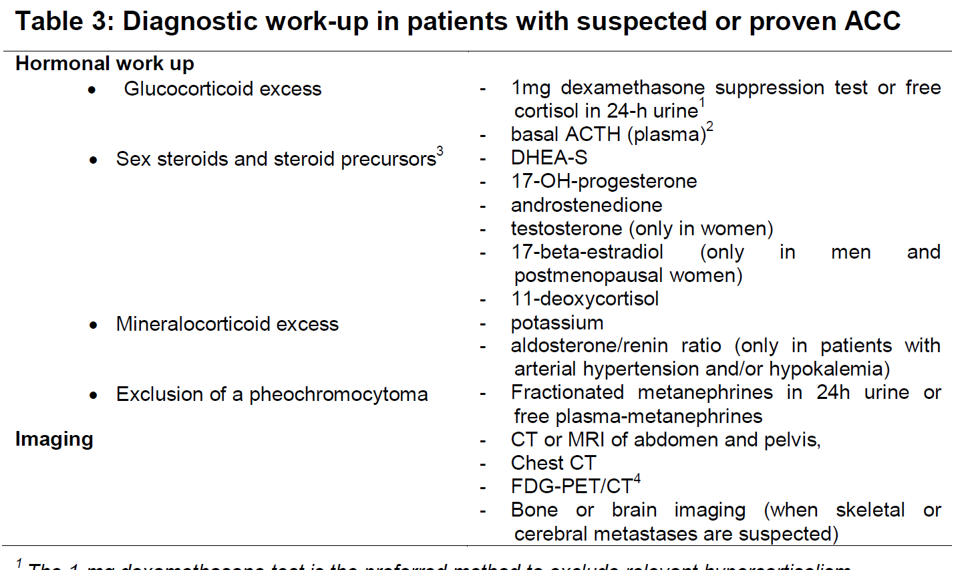
Diagnostics
We referred mainly to the ESE-ENSAT guidelines on adrenal incidentaloma (Fassnacht et al. EJE 2016)

Slide 11
ACC guidelines
A few methodological remarks

Slide 12
What’s behind a recommendation?
Publication bias
High quality studies
Low quality studies
Clinical experience
Incomparable studies
Search strategies
Personal opinions
Selective reporting
Conflicts of interest
Inconsistent results
Patient preferences

Slide 13
GRADE approach
Define clinical questions
Systematic review
Quality of evidence (4 categories)
  High/moderate /low/very low (++++/+++O/++OO/+OOO)
Recommendations (2 grades)
  Strong (‘we recommend’)
  Weak (‘we suggest’)
Notes:
13

Slide 14
Strong versus weak recommendation
Strong recommendation:
Reasonably informed persons (clinicians, politicians and patients) would want the management in accordance with the recommendation.
Weak recommendation:
Most persons would still act in accordance with the guideline, but a substantial number would not.
Andrews 2013; 66 726-735 J Clin Epi

Slide 15
From evidence to recommendation
Evidence
Values
Preferences
Clinical experience
Costs
Resources
Recommendations

Slide 16
ACC: 4 key clinical questions
In total, 5988 publications have been screened
Diagnostic accuracy pathology (17 studies included)
Prognostic markers (35 studies included)
Adjuvant treatment
  Mitotane (6 studies included)
  Radiotherapy (3 studies included)
Treatment for recurrent/advance disease (46 studies included)

Slide 17
Evidence for clinical management in ACC?
Evidence for most of the clinical recommendations: (very) low
No evidence based on RCTs for
  Optimal diagnostic algorithm
  Optimal adjuvant treatment (mitotane/radiotherapy)
Two large RCTs for treatment of advanced/recurrent disease
Given the large number of drugs for advanced/recurrent disease optimal strategy not known with certainty

Slide 18
Adjuvant treatment
Bias to consider
Confounding (non-comparability)
Immortal time bias

Slide 19
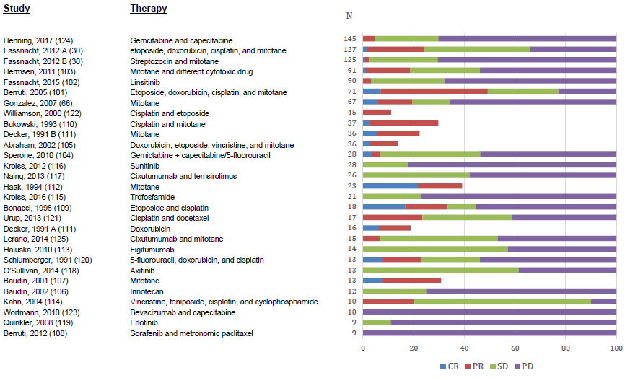
Treatment for advanced disease
Comparison single arm studies
Many different (combination) of drugs
Shows that: some objective response (~20%) is to be expected

Slide 20
In the absence of strong evidence…
“ It is certain that high-quality evidence will not be available in all clinical situations, and in situations where high-quality evidence is not available, expert opinion and careful synthesis of low quality evidence will continue to appropriately guide clinical practice.”

Slide 21

In the absence of strong evidence…
We can not abstain from guidance because the evidence is not solid
But: recommendations should still be reasonable

Slide 22
SURGERY

Slide 23
Surgery for suspected localized ACC
R.3.1. We recommend that adrenal surgery should be performed only by surgeons experienced in adrenal and oncological surgery.
R.3.2. We recommend complete en bloc resection including the peritumoral/periadrenal retroperitoneal fat and if required adjacent organs. However, we suggest against the routine resection of the ipsilateral kidney in the absence of direct renal invasion.
What defines expertise?
Minimum of >6 ADX/year
Better if >20 ADX/year
What extent of surgery?
No partial adrenal resection or tumor enucleation
No routine nephrectomy if kidney not involved

Slide 24
Surgery for suspected localized ACC
R.3.3. Open surgery is the standard surgical approach for confirmed or highly suspected ACC. Therefore, we recommend open surgery for all tumors with radiological findings suspicious of malignancy and evidence for local invasion.
For tumors < 6 cm without any evidence of local invasion, laparoscopic adrenalectomy (respecting the principles of oncological surgery) is reasonable.

Slide 25
Open surgery
Laparoscopy
Few available studies
All retrospective and prone to bias
Conflicting results

Slide 26
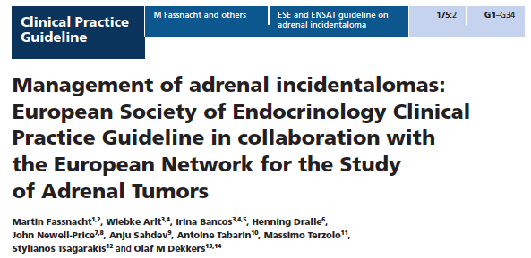

Unilateral
adrenal mass
Relevant
hormone excess?
No
Radiological suspicion
of malignancy?
Yes
Local
invasion ?
Diameter
≤ 6 cm ?
No
Yes
No
Yes
Yes
No
No
Surgery
Laparoscopic
adrenalectomy
Individualized
surgical approach
Open
Adrenalectomy

Slide 27
Surgery for suspected localized ACC
R.3.4. We suggest that routine locoregional lymphadenectomy should be performed with adrenalectomy. It should include the periadrenal and renal hilum nodes. All suspicious or enlarged lymph nodes should be removed.
Lymphadenectomy is rarely done and assessed at pathology
Evidence that is linked with better RFS
No re-do surgery if not done

Slide 28
Pathology and prognostic factors

Slide 29
Pathology
Minimal Expertise
R.4.1. We recommend that the diagnosis of ACC should be confirmed by histopathology (+++O).
On resection specimen (biopsy is usually not indicated?)
Majority of panelists argued that histology is dispensable in selected cases unequivocal ACTH-independent steroid excess.
R.4.2. We suggest that all adrenal tumors, which cannot be readily classified, and all suspected ACC, should be reviewed by an expert adrenal pathologist (++OO)
10% of misdiagnosis

Slide 30
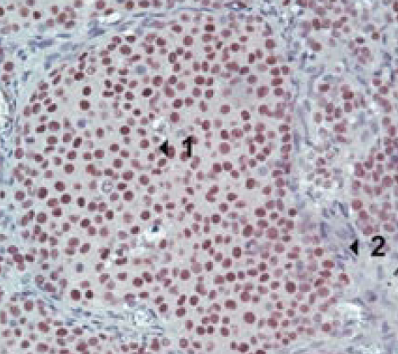
Pathology
Differential diagnoses
R.4.3. We suggest the use of immunohistochemistry for steroidogenic factor-1 (SF1) for the distinction of primary adrenocortical tumors and non-adrenocortical tumors (+OOO)
SF-1 staining in ACC
Sbiera et al. JCEM 2010

Slide 31
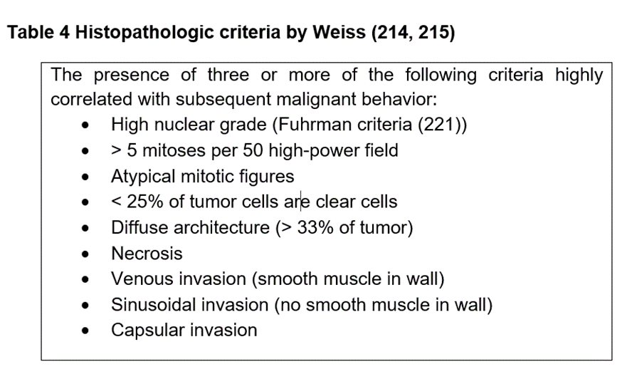
Pathology
The Weiss score
R.4.4. We recommend the use of the Weiss system for the distinction of benign and malignant adrenocortical tumors (++OO)
0-2: benign
3-9: malignant
Special: oncocytic variants
Scores of 2-3 may be borderline

Slide 32
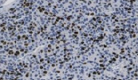
Pathology
Proliferation index
R.4.5. We recommend the use of Ki67 immunohistochemistry for every resection specimen of an adrenocortical tumor (++OO)
In areas of highest labelling
(alternative: mitotic count)
Papathomas et al. Am J Surg Pathol. 2016

Slide 33
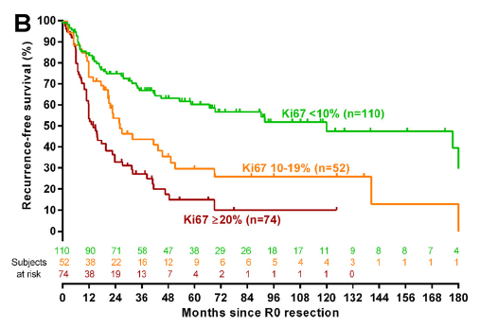
Major Prognostic Role of Ki67 in ACC after Complete Resection
Beuschlein et al., JCEM 2015

Slide 34
Pathology
The report
R.4.6. We recommend that the pathology report of a suspected ACC should at least contain the following information (+OOO):
Weiss score (including the exact mitotic count)
exact Ki67 index
resection status
pathological tumor stage
  invasion of the capsule and/or surrounding tissue and organs
  nodal status

Slide 35
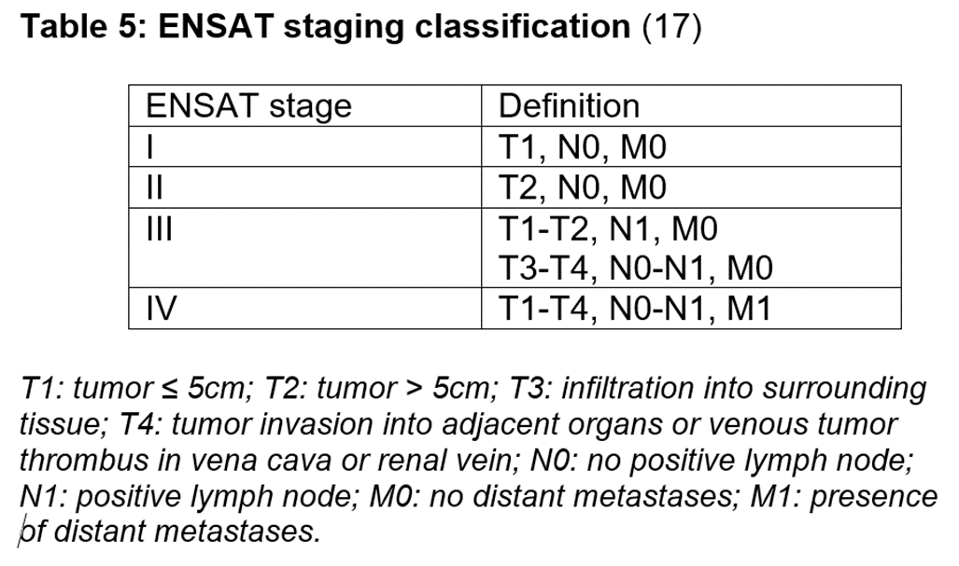
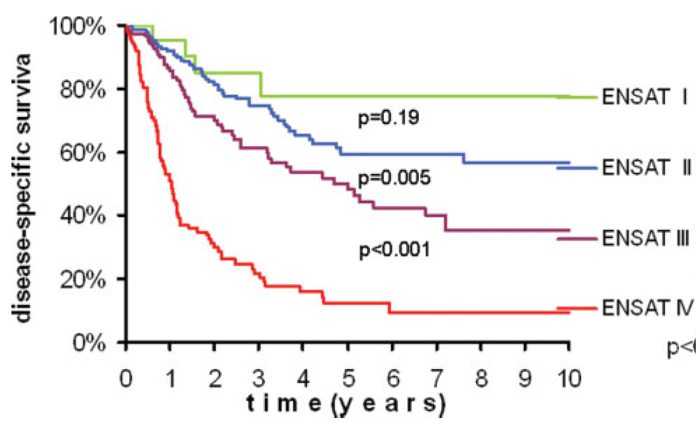
Prognosis
Initial staging
R.5.1. At initial diagnosis, we recommend using the ENSAT staging classification (+++O)
Fasssnacht et al. Cancer 2009

Slide 36
Prognosis
Initial prognostic factors
R.5.2. At initial diagnosis, we recommend taking the following factors into account when assessing the prognosis and treatment options (++OO):
  tumor stage
  resection status
  Ki67 index (or mitotic count)
  autonomous cortisol secretion
  the patient's general condition

Slide 37
Prognosis
2 distinct situations
Localized disease (stage I-III): risk of recurrence?
  Low/moderate risk : stage I-II and R0 and Ki67<10%
  High risk: stage III or R1 or Ki67>10%
Advanced disease (stage IV, unresectable, R2): specific survival?
  High tumor burden
  High tumor grade, high Ki67 index
  Uncontrolled symptoms
  Fast kinetics of tumor growth

Slide 38
Prognosis
During follow-up
R.5.3. During follow-up, we recommend re-assessing prognosis at each evaluation, to guide treatment strategy
  After complete surgery:
    recurrence?
  At the time of recurrence:
    time from surgery, tumor burden, resectability?
  Advanced disease:
    Ki67, tumor burden, general condition, kinetics of growth, response to treatment?

Slide 39
Methods and time interval of follow-up examinations
R.6.1. We recommend following patients with regular cross-sectional imaging of the abdomen, pelvis and chest.
R.6.2. After complete resection, we suggest radiological imaging every 3 months for 2 years, then every 3-6 months for a further 3 years.
The majority of the panel suggests continuation of follow-up imaging beyond 5 years, but surveillance should then be adapted.

Slide 40
ADJUVANT THERAPY

Slide 41
ADJUVANT THERAPY
Is adjuvant therapy able to prevent recurrent disease or reduce mortality after radical resection?
  MITOTANE (n=6 papers included)
  RADIATION THERAPY (n=3 papers included)
  CHEMOTHERAPY (n=0 papers included)
STUDY CHARACTERISTICS
ACC operated on with R0, R1, Rx
Intervention group (>10 pts) & control group
Baseline data with age- and stage-adjusted estimates
<25% overlap with other studies

Slide 42
Paper | N. | Study characteristics | Patient characteristics
Berruti (2017) | 47 MIT 45 CTR 70 CTR | Treatment per center policy Landmark analysis at 3 mo. Treatment duration 42 mo. Median follow-up >120 mo. | Stage IV in 13% of mitotane group vs. 9% and 1% of control groups
Postlewait (2016) | 88 MIT 119 CTR | Landmark analysis at 30 d Treatment duration 6 mo. Median follow-up 44 mo. | Stage IV in 28% of mitotane vs. 9% of control group Hormone secretion in 58% of mitotane vs. 32% of control group
Beuschlein (2015) | 63 MIT 235 CTR | Study not originally aiming to assess outcome of adjuvant mitotane | 28% are stage III in both mitotane and control groups
Else (2014) | 105 MIT 159 CTR | 40% of pts received RDT Median follow-up 46 mo. | Non-significant excess of adverse prognostic factors in mitotane group
Grubbs (2010) | 22 MIT 196 CTR | Treatment duration >2 mo. Median follow-up 88 mo. | Non-significant excess of adverse prognostic factors in mitotane group
Bertherat (2007) | 65 MIT 101 CTR | Published as letter to the Editor | Cortisol secretion in 77% of mitotane group vs. 41% of control group

Slide 43
Paper | N. | Study characteristics | Patient characteristics
Berruti (2017) | 47 MIT 45 CTR 70 CTR | Treatment per center policy Landmark analysis at 3 mo. Treatment duration 42 mo. Median follow-up >120 mo. | Stage IV in 13% of mitotane group vs. 9% and 1% of control groups
Postlewait (2016) | 88 MIT 119 CTR | Landmark analysis at 30 d Treatment duration 6 mo. Median follow-up 44 mo. | Stage IV in 28% of mitotane vs. 9% of control group Hormone secretion in 58% of mitotane vs. 32% of control group
Beuschlein (2015) | 63 MIT 235 CTR | Study not originally aiming to assess outcome of adjuvant mitotane | 28% are stage III in both mitotane and control groups
Else (2014) | 105 MIT 159 CTR | 40% of pts received RDT Median follow-up 46 mo. | Non-significant excess of adverse prognostic factors in mitotane group
Grubbs (2010) | 22 MIT 196 CTR | Treatment duration >2 mo. Median follow-up 88 mo. | Non-significant excess of adverse prognostic factors in mitotane group
Bertherat (2007) | 65 MIT 101 CTR | Published as letter to the Editor | Cortisol secretion in 77% of mitotane group vs. 41% of control group

Slide 44

MITOTANE

Slide 45
MITOTANE

Slide 46
ADJUVANT MITOTANE THERAPY
R.8.1. For adrenal tumors with uncertain malignant potential, we recommend against adjuvant therapy (+OOO).
R.8.2. We suggest adjuvant mitotane treatment in patients without macroscopic residual tumor after surgery that have a perceived high risk of recurrence (+OOO).
High risk: stage III or R1 resection or Ki67 > 10%
However, we cannot suggest for or against adjuvant therapy for patients at low/moderate risk of recurrence (stage I-II, R0 resection and Ki67 ≤ 10%).

Slide 47
ADJUVANT MITOTANE THERAPY
R.8.3. Once the decision for mitotane treatment is established, we recommend starting mitotane as soon as clinically possible after surgery (+OOO).
R.8.4. In patients without recurrence who tolerate mitotane in an acceptable manner, we suggest to administer adjuvant mitotane for at least 2 years, but not longer than 5 years (+OOO).

Slide 48
ADJUVANT RADIATION THERAPY
Paper | N. | Study characteristics | Patient characteristics
Else (2014) | 59 RDT 217 CTR | Most pts. received RDT at reference institution Median follow-up 46 mo. | Non-significant excess of adverse prognostic factors in RDT group; 71% of pts. received mitotane
Habra (2013) | 22 RDT 196 CTR | All patients received RDT outside reference institution 6% of patients had R2 resection Median follow-up 1.8 yrs in RDT and 2.8 yrs in CTRL group | Part of the patients received mitotane (4 in RDT and 10 in CTR)
Fassnacht (2006) | 14 RDT 14 CTR | 50% of patients received RDT at reference institution Median follow-up 36 mos | Part of the patients received mitotane (5 in each group)

Slide 49
ADJUVANT RADIATION THERAPY
Recurrence-free Survival

Slide 50
ADJUVANT RADIATION THERAPY
Overall Survival

Slide 51
ADJUVANT RADIATION THERAPY
R.8.5. The panel did not come to a definitive consensus on adjuvant radiation therapy.
We suggest against the routine use of radiation therapy in patients with stage I-II and R0 resection (+OOO). The panel suggests considering radiation in addition to mitotane therapy on an individualized basis therapy in patients with R1 or Rx resection or in stage III.
R.8.6. We recommend starting treatment asap after surgery and to deliver a dose of 50-60 Gy (+OOO).

Slide 52
ADJUVANT CHEMOTHERAPY
R.8.7. The panel did not come to a definitive consensus on adjuvant use of cytotoxic drugs. We suggest against the routine use of cytotoxic drugs in the adjuvant setting. However, the panel suggests considering adjuvant chemotherapy in selected patients with very high risk for recurrence.
Some members of the panel are currently using cisplatin ± etoposide in pts at perceived very high risk of recurrence (e.g. Ki67 >30%, large tumor thrombus in the vena cava, stage IV, or R1 resection).

Slide 53
Always consider clinical trials
ACC amenable to complete resection
complete resection (R0)
Rx or R1 resection²
ENSAT I+II and Ki67 ≤10%
ENSAT III+IV or Ki67 >10%³
Low/intermediate risk
High risk
Consider mitotane
Adjuvant mitotane
Adjuvant mitotane
+ consider radiation therapy
S u r g e r y
Follow-up every 3 months:
imaging and tumor markers
Tumor free
Recurrence
DFI > 12 months +
completely resectable
DFI < 6 months or not resectable
See figure 4
Notes:
DFI disease-free interval between complete resection and recurrence
¹ All patients with stage I+II and most patients with stage III should be amenable to radical resection. If complete resection is not feasible, consider neo-adjuvant treatment (e.g. mitotane + cisplatin or EDP). In selected patients with single metastases complete resection might be possible as well.
² In patients with R2 resection, consider re-surgery by an expert surgeon (see R.3.6) or see Figure 1B
³ If Ki67 staining is not available, a low (<20 mitoses / 50 high power fields) or a high mitotic rate (> 20 mitoses / 50 high power fields) may be used for risk stratification.
⁴ Individual decision (see R.. If possible enroll in clinical trial like ADIUVO (www.adiuvo-trial.org).
⁵ In some patients (e.g. Ki67 >30%. large tumor thrombus in the vena cava, stage IV, or R1 resection) consider additional cytotoxic therapy (e.g. 4 cycle of cisplatin + etoposide).
⁶ After two years the time intervals are gradually extended.
⁷ If the disease-free interval is between 6 and 12 months or in patients with DFI > 12, in whom complete resection is not possible, an individual approach is required (see R.9.7.)

Slide 54
Therapy of advanced ACC

Slide 55
What is the role of surgery in advanced ACC ?
R.8.1. For patients presenting with limited intra-abdominal metastases we suggest surgical therapy if complete resection of all lesions seems feasible (+OOO).
In case of limited extra-abdominal lesions, we suggest adrenal tumor resection in conjunction with therapy aiming at long-term tumor control of the other lesions (+OOO).
In all patients, we recommend to start mitotane therapy as soon as clinically possible (+OOO).
R.8.3. We suggest against the routine use of adrenal surgery in case of widespread metastatic disease (+OOO).

Slide 56
Advanced ACC not amenable to radical resection
No prior systemic therapy
Recurrence during adjuvant mitotane
Mitotane
+/- local therapies
Mitotane
+ EDP
Local therapies
+ mitotane
The panel is convinced that local therapeutic measures (e.g. radiation therapy, radiofrequency ablation, cryoablation, microwave ablation, chemo-embolization) are of great value for therapy of advanced ACC.
We suggest individualization of the decision on the method of choice (+OOO).
Published evidence extremely low
(if at all, one small study per method)

Slide 57
Advanced ACC not amenable to radical resection
No prior systemic therapy
Recurrence during adjuvant mitotane
Mitotane
+/- local therapies
Mitotane
+ EDP
Local therapies
+/- mitotane
R.8.4. In patients with advanced ACC not qualifying for local treatment, we recommend either mitotane monotherapy or mitotane + EDP depending on prognostic parameters (+++O).
Only positive phase III trial

Slide 58
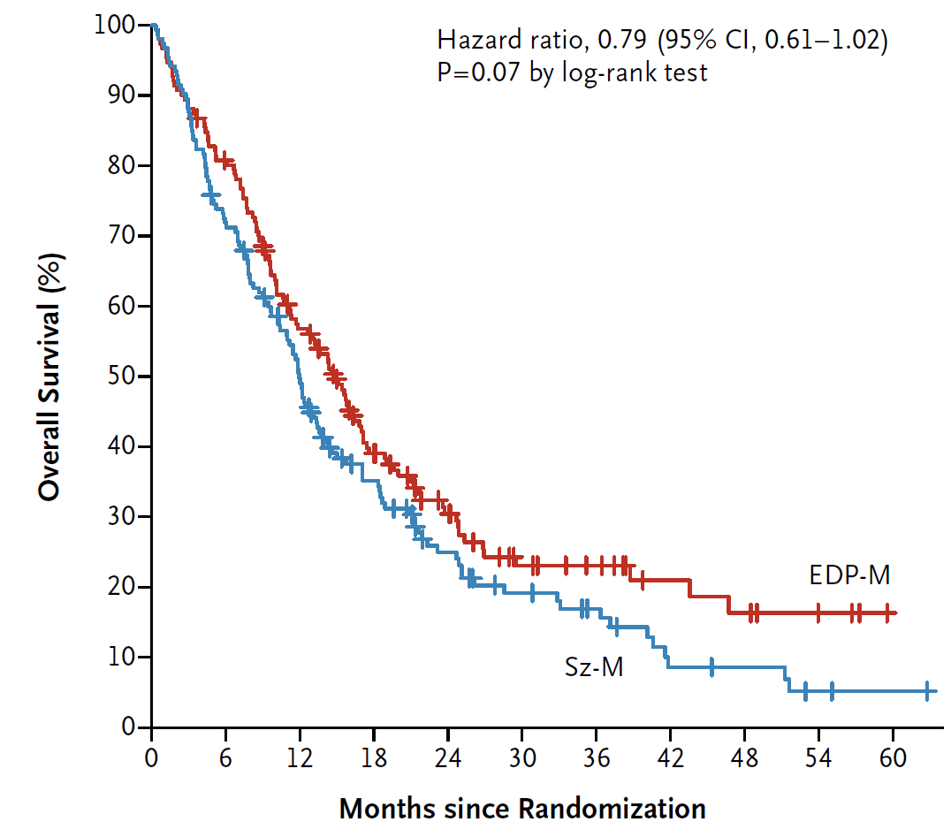
First randomized trial in ACC
FIRM-ACT study
304 patients from 12 countries
Number of affected organs:
median 3 (1-8)
212 patients (70%) were
pretreated with mitotane
HR 0.79 (0.61-1.02)
P=0.069
EDP-M: 14.8 months
Sz-M:
12.0 mo
Fassnacht, Terzolo et al. NEJM 2012

Slide 59
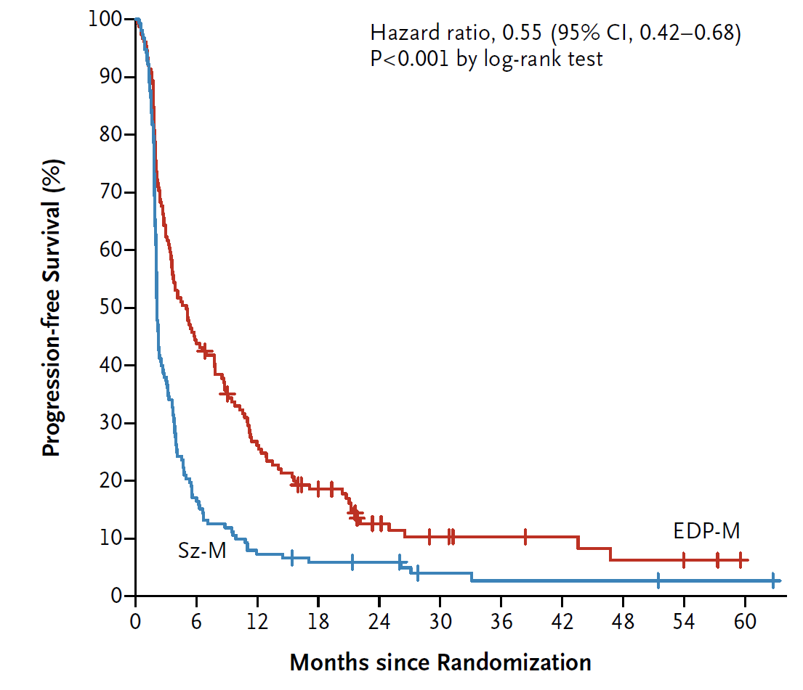
First randomized trial in ACC
FIRM-ACT study
304 patients from 12 countries
Number of affected organs:
median 3 (1-8)
212 patients (70%) were
pretreated with mitotane
No difference in quality of life
and serious adverse events
HR 0.55 (0.42-0.68) P<0.0001
EDP-M
median PFS 5.0
vs. 2.1 months
Sz-M
Fassnacht, Terzolo et al. NEJM 2012

Slide 60
When to start with mitotane monotherapy?
Retrospective analysis of 127 patients with advanced ACC and mitotane monotherapy
=> If there are unfavorable prognostic markers (e.g. high tumor burden, uncontrolled symptoms, high Ki67…) then EPD-M is probably the better first choice.
Initiation at delayed
recurrence (> 360 d)
> 10 tumoral
lesions
Megerle et al. JCEM 2018

Slide 61
How to deal with recurrence after radical resection?
Key question: how long was the disease-free interval?
R.8.5. …disease-free interval > 12 months and complete resection feasible: we recommend surgery or alternatively other local therapies (+OOO).
R.8.6. … disease-free interval < 6 months: we recommend EDP-M (++OO).
R.8.7. For all other patients with recurrent disease an individualized approach is needed.

Slide 62
Advanced ACC not amenable to radical resection
Always consider clinical trials
No prior systemic therapy
Recurrence during adjuvant mitotane
Mitotane
+/- local theraphies
Mitotane
+ EDP
Local theraphies
+/- mitotane
Follow - up every 2-3 months
Partial response or stable disease: continue therapy + consider surgery
Progressive disease
Mitotane plus
EDP or local therapies
Consider
additional therapy
Mitotane plus
EDP

Slide 63
What to do in patients progressing EDP-M?
R.8.10. In patients who progress under EDP-M, we suggest considering additional therapies including clinical trial on an individual basis (+OOO).
If there is a suitable clinical trial, this would be our first choice
Always (re-)consider local therapies
Two reasonably well-studies second-line therapies are:
  Gemcitabine + capecitabine (Sperone ERC 2010, Henning JCEM 2017)
  Streptotocozin + mitotane (Fassnacht NEJM 2012)
„lack of convincing evidence“

Slide 64
When to stop mitotane?
R.8.11. The optimal timing of mitotane discontinuation is currently unknown and the panel could not come to a specific recommendation on this issue.
Part of the group favors to discontinue mitotane in all patients who experienced progressive disease after one year of mitotane (Vezzosi Horm Cancer 2017)
Other panelists consider mitotane discontinuation when there is progressive disease despite mitotane blood levels > 14 mg/L
A last group continues mitotane indefinitely

Slide 65
Special considerations on mitotane

Slide 66
Mitotane, six items to consider
R.10.1. Start in an escalating regimen
R.10.2. Monitor blood concentration
R.10.3. Glucocorticoid replacement
R.10.4. Monitor side effects
R.10.5. Be aware of drug interactions
R.11.3. Avoid pregnancy

Slide 67
1. Start up
We recommend starting mitotane in an escalating regimen depending on performance status and tolerability.

Slide 68
1. Start up
We recommend starting mitotane in an escalating regimen depending on performance status and tolerability.
High starting dose: 1.5 g day 1 → 6 g day 4
Low starting dose: 1 g day 1 → 3-4 g day 14
  Tolerability
Target level > 14 mg/L

Slide 69
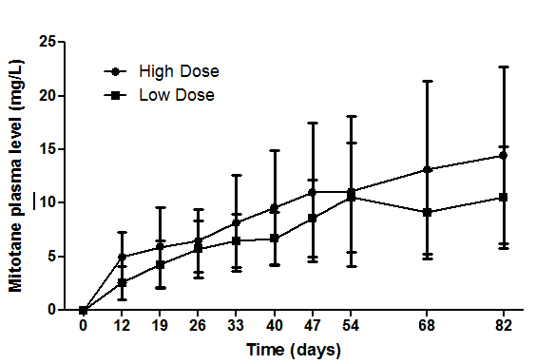
Different mitotane starting regimens
Kerkhofs et al JCEM 2013

Slide 70
2. Monitor plasma levels
We recommend monitoring blood concentration of mitotane. General aim is to reach blood level above 14 mg/L.
Assess plasma level every 3-4 weeks
  After plateau
    less frequent plasma monitor
    lower dose possible

Slide 71
2. Monitor plasma levels
We recommend monitoring blood concentration of mitotane. General aim is to reach blood level above 14 mg/L.
Assess plasma level every 3-4 weeks
  After plateau
    less frequent plasma monitor
    lower dose possible
Adjust dose according to side effects and level
Max target level 30 mg/L, usually 20 mg/L
Same protocol adjuvant and metastatic disease

Slide 72
3. Glucocorticoid replacement
We recommend glucocorticoid replacement, high dose usually required.
Start 20 mg/d together with mitotane; later in Cushing’s
High doses needed: 50 – 100 mg/d
  Increased clearance and increased CBG
Monitor clinically
  ACTH level (?)
Consider mineralocorticoid supplementation (in case of hypotension, hyperkalemia, hyponatremia)

Slide 73
4. Monitor adverse effects
We recommend regular monitoring of mitotane-induced adverse effects.
Gastro-intestinal
Central nervous system
Psychological and social

Slide 74
5. We recommend to be aware of mitotane drug interactions
Adverse Effect | Frequency
Gastrointestinal: nausea, vomiting, diarrhea, anorexia | very common
Adrenal insufficiency | very common
CNS: lethargy, somnolence, vertigo, ataxia Confusion, depression, dizziness, decreased memory | very common common
Increase of hepatic enzymes (in particular gamma-GT) | very common
Liver failure | rare
Hepatic microsomal enzyme | very common
Increase in hormone binding globulins (CBG, SHBG, TBG, etc.) | very common
Disturbance of thyroid parameters | very common
Hypercholesterolemia, hypertriglyceridemia | very common
Primary hypogonadism in men | common
Gynaecomastia | common
Skin rash | common
Prolonged bleeding time | common
Leucopenia | common
Thrombocytopenia, anemia | rare
Autoimmune hepatitis | rare
Cardiovascular: hypertension | very rare
Ocular: blurred or double vision, toxic retinopathy, cataract, macular edema | very rare
Hemorrhagic cystitis | very rare

Slide 75
4. Adverse effects
We suggest starting supportive therapy before severe toxicity occurs.
Antiemetic and anti-diarrheal
Psychological
Lifestyle – advices
Levothyroxine to consider
Testosterone also, seldom
Statine?

Slide 76
Recommended monitoring
Parameter | Interval | Comment
Mitotane blood level | Every 3-4 weeks, as soon as plateau of blood level is reached every 2-3 months | Target blood level > 14 mg/L
GOT, GPT, bilirubin, (gGT) | Initially every 3-4 weeks, after 6 months every 2-3 months | GGT is invariably elevated w/o clinical consequences. If other liver enzymes are rapidly increasing (> 5-fold of baseline), there is risk of liver failure: interrupt mitotane
Blood count | Initially after 3-4 weeks, then every 3-4 months | Check for rare and in most cases not significant leucopenia, thrombocytopenia, and anemia

Slide 77
Suggested monitoring
ACTH | Suspected glucocorticoid deficiency or excess | ACTH in the normal range or slightly above
TSH, fT4 | Every 3 – 4 months | Only recommended in patients with clinical symptoms of hypothyroidism
Renin | Every 6 months | If renin ↑ and symptoms of hypoaldosteronism, add fludrocortisone
Cholesterol (HDL, LDL) | Every 3-4 months (in adjuvant setting) | If LDL / HDL cholesterol ↑↑ consider statins in selected cases.
Testosterone and SHBG in men | Every 3-4 months (in adjuvant setting) | If testosterone ↓ and symptoms of hypogonadism, add testosterone

Slide 78
5. Mitotane interactions
We recommend to be aware of mitotane drug interactions.
Strong induction of CYP3A4 (Krois et al Clin Endocrinol 2011)
  Benzo’s - Antibiotics
  Contraception - Statins
  Steroids - Tyrosine kinase inhibitors
  Antiemetics - mTOR inhibitors
  Analgetics - Taxols
  Antihypertensive med - Antracyclines
  Haloperidol - etc etc

Slide 79
6. Avoid pregnancy
We recommend avoiding pregnancy while being on mitotane treatment.
Potential teratogenic effects
Ensure effective contraception
Ensure undetectable levels before considering pregnancy

